Slide 1
Qualitative Data Analysis
Andreas Kaufmann and Dirk Riehle, Univ. Erlangen
NYT B03
Licensed under CC BY 4.0 International

Slide 2
Fundamentals

Slide 3
Overview 1 / 2
What is qualitative data?
Any information that can not be reduced to a numerical representation
For example: Data related to concepts, opinions, behavior and social activities
Methods of data collection
Interviews (in-depth / semi-structured / structured)
Focus groups
Observation
Immersion
Literature search

Slide 4
Overview 2 / 2
What is qualitative data analysis?
A form of inquiry to answer questions about what, why and how people think, act or experience a phenomenon
Interpretative analysis
Where are the analysis results used?
Theory building research, very heavily in sociology and market research
How is the data analyzed?
Coding (more on that later)

Slide 5
Qualitative vs. Quantitative Research
 | Qualitative | Quantitative
Purpose | Gaining insight into the phenomenon of interest | Measuring magnitude (How common is the phenomenon? Are there shared statistical significant characteristics among the participants?)
Format | Open discussions, interviews | Structured categories of data
Data | Explanatory data from small sample | Data from representative sample
Analysis | Hypothesis generating: form of outcome is not pre-defined a-priori | Hypothesis testing
Process | Iterative | Linear
Result | Common concepts and ideas (the theory); individual responses | Numerical aggregation of clustered responses; accepted or rejected hypotheses
Sampling | Theoretical | Statistical

Slide 6
Research Framework
Can be performed in the context of a qualitative research framework
Grounded Theory (GT), Dimensional Analysis, etc.
Can be performed independent of a qualitative research framework
Technique useful for SLRs, Qualitative Surveys, Case Studies, etc.
Some methods, such as thematic analysis, are explicitly independent of any frameworks
Most appropriate for theory-building research

Slide 7
Basic Principles
Iterative Process
Data gathering and analysis in parallel
Stopping criterion: Saturation
Data should be collected as long as the subsequent analysis yields no changes to the resulting theory any more.
Conduct interview
Create interview guideline
Determine what data to gather next
Saturation
Done
Analyze interview

Slide 8
Sampling
Theoretical sampling
Identify the gaps in the theory and potential conflicts after each iteration and determine appropriate data to gather only for the next iteration
By many considered the gold standard of qualitative research
With defined sampling model
Identify the dimensions of relevance through an a-priori literature review
Edge-case, Typical-case, Polar-case, etc.
Consider stratified random sampling

Slide 9
Coding

Slide 10
Coding
Coding is a form of data analysis in which theoretical constructs emerge from the data in the form of codes,
Codes are hierarchically structured
Segments of data are assigned to the codes representing these constructs
The codes and their hypothesized relationships are evidenced in the data
The sum of all codes and their relationships form a theory about the phenomenon under investigation

Slide 11
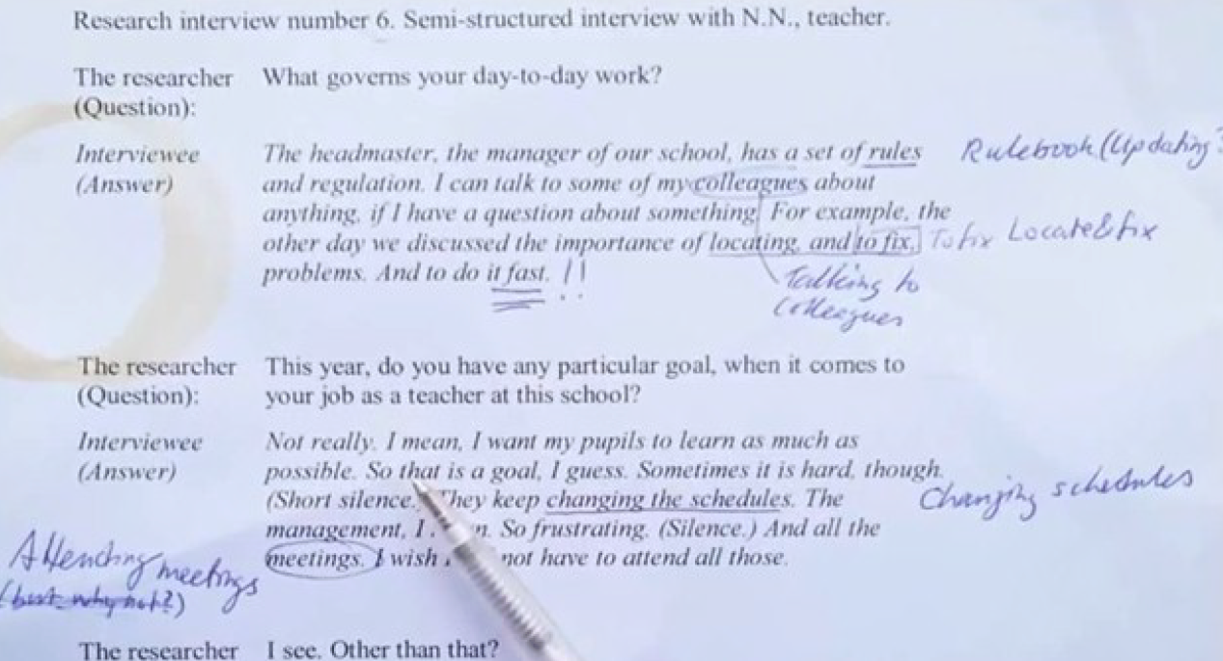
Coding, then

Slide 12
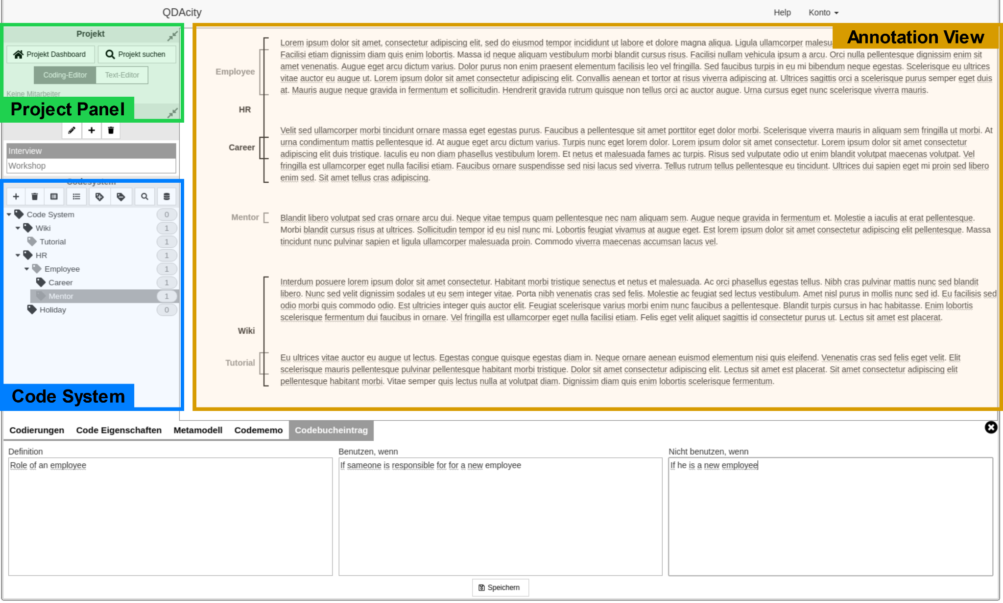
Coding, now

Slide 13
Coding
Can be performed in three distinct steps
Open coding
Axial coding
Selective Coding
Other types of process-phases exist (compare thematic analysis)

Slide 14
Open Coding
Identify key concepts
Identify similar terms, synonyms
Determine concept codes
May be terms, actions, relationships
Codify using symbol, term, or desc.
Annotate text with concept codes
Annotate using concept codes
Use codes consistently
Memo writing!

Slide 15
Axial Coding
Identify relationships between codes
Equivalence class of atomic concepts
Category hierarchy follows
Should form a single-rooted hierarchy
Mutually exclusive, completely exhaustive
Other types of relationships can be documented in memos

Slide 16
Axial Coding: Coding Paradigm
Context & Intervening Conditions
Agile development
Competition
Internal supplier
…
Causal Conditions
Customer Requirements
Maintainability
Hardware compatibility
…
Consequences
Style guides
Designated UXD expert
Common terminology
…
Phenomenon
UXD in PLE
Action and Interaction Strategies
Communication w/ stakeholders
Feedback collection
Testing, Q&A
…

Slide 17
Selective Coding
Giving categories context and making sense of them
Writing memos, code book
A theory (from data) is the root category of the category hierarchy
“Core category”
At any given level of the hierarchy, term categories link by relationship categories
At this stage, no need for validation, but theory should “make sense”

Slide 18
Rigor in Qualitative Data Analysis

Slide 19
Dimensions of Rigor
Qualitative theory building research is often assessed in the naturalistic research paradigm
Guba & Lincoln: Trustworthiness
Credibility
Transferability
Dependability
Confirmability

Slide 20
Dimensions of Rigor
Showing rigor of execution
Explicit evaluation
You need both!

Slide 21
Peer debriefing
Design and process is laid out to a researcher from outside the project
The external researcher questions and critiques the approach to find possible flaws
Session is documented with a peer debriefing protocol
Should be done at multiple stages to validate the
Research design and fit for the research question
Recruiting and sampling
Data gathering
Data analysis

Slide 22
Intercoder Agreement
Intercoder agreement is the extent to which two or more individuals agree on the coding of qualitative data
Interrater reliability can be used to control the researcher’s bias towards the studied phenomenon
May be applied to different units of coding (e.g. sentence or paragraph level)
Most common metrics for measuring: Kappa Statistic, Krippendorf’s Alpha

Slide 23
Code Book
A code book describes the code system
It can include
A definition for each code
Instructions for when to use the code
Possible disambiguations towards other (similar) codes
An exemplary piece of data to be coded with each code

Slide 24
Measuring Saturation
Track changes within your project
New codes
Changes to definitions
etc.
Plot those changes against amount of new data gathered
The code system should reach a steady state where there are little to no changes when new data is added

Slide 25
Member Checking
Feedback from study participants / stakeholders
Increases credibility and validity of the study
During data gathering (interviewing)
Active / reflective listening
After analysis
Mirror findings back to stakeholders / experts to confirm correct understanding of the phenomenon

Slide 26
Triangulation
Data triangulation
The code system can ensure consistency between different types and sources of data
Investigator triangulation
Intercoder agreement
Peer debriefing
Theory triangulation
Peer debriefing
Methodological triangulation
Different types of data gathering
Mixed methods (in addition to the qualitative part)
Environmental triangulation
Awareness of the impact of different settings (in the field vs isolated)
See Guion (2002) for a very short but good overview of the definitions

Slide 27
Coding Exercise

Slide 28
Overview
Qualitatively code a group of documents following a provided codebook
Download codebook from StudOn
Each student will be given 6 documents
Documents may not be shared with anyone
Four exercises
QDA Exercise 1 – code documents “Rick” and “Morty”
QDA Exercise 2 – code documents “Margery” and “Homer”
QDA Exercise 3 – code documents “Kyle” and “Stan”
QDA Exercise 4 – 1-2 page conclusion to the research question of your choice based on your coding
QDA Exercise 1-3 are performed on QDAcity. Submit your work on the “Exercise Dashboard”
QDA Exercise 4 requires submission on StudOn
For explanation how to join the course on qdacity see here

Slide 29
Learning Process
Read the codebook very carefully
Use QDAcity for coding
Work individually
We will evaluate your weekly work on Mondays after class
Recode the already coded document in each new week to make your coding consistent
Post your questions on the StudOn form for NYT (be specific about what you don't understand or find unclear)

Slide 30
Process on QDAcity
In QDAcity the QDA exercise is just one exercise which you continue to work on
However, the deadlines for the specific documents to be coded in Exercise 1, 2 and 3 are still relevant
After each week we will create an intercoder agreement report
This will show up on your exercise dashboard, where you also see the statistics of your project

Slide 31
Peer Feedback on QDAcity
After the report is generated you have the option of giving other course participants feedback on their coding
For you this might have the benefit of seeing how other people work and potentially be inspired or see things that you overlooked and might do differently.
If you do request other participants’ submission for peer feedback, do make an effort to give constructive feedback
Giving feedback is not required, but if you do do it, do it so it helps out your fellow students

Slide 32
Final Artifact
For Method Exercise 4, submit your 1-2 page conclusion to StudOn
Submit as a PDF file
State which research question you are answering
You may chose the specific wording of the research question your conclusion should answer (using the data from the project)
If you don’t want to come up with your own specific question, you may write about answering the general research question of “What are the most important challenges for remote work, and how are they addressed in industry?”
Maximum of 2 pages

Slide 33
Grading
Grading of coding (ME 1 - ME 3) based on intercoder agreement
Your work is compared to original coding
We examine accuracy – both precision and recall – so indiscriminate coding is not advised
Differences of a few words or punctuation are not considered
Grading is automated
Sum of coding exercises calculated as follows:
ME 1 – 15%
ME 2 – 15%
ME 3 – 40%
ME 4 – 30%

Slide 34
Code Hierarchy
Do not apply category codes (eg. Codes with other codes below it); only use codes with no codes beneath them in the hierarchy.
In the following example, code A should not be used:
Category A
Concept B
Concept D
Concept E

Slide 35
Question Prompts
Do not code the interviewer's question, except when it is needed to supply context.
In this example, the question provides context and is coded if the answer is coded:
Interviewer: Have you ever seen a zebra?
Interviewee: Yes, in Tanzania.
In this example, the question is not necessary to understand and is not coded even if the answer is:
Interviewer: Have you encountered a monkey?
Interviewee: A monkey stole my glasses in Shimla.

Slide 36
Coding Granularity
Coding can be done at the multi-paragraph, paragraph, sentence or phrase level.
These examples are all valid codings for an imaginary code 'cat' defined as all references to cats:
I like cats, but I also like dogs. My neighbors got a new cat last month, but it likes to sleep at my house.
Cats are the best when they come to to snuggle you when you're feeling down. I know people say cats are aloof, but mine always knew when I was sad and would come to cheer me up. I do find them annoying at times, for instance when they dig up the garden or yowl at night.
Note that examples in the codebook do not necessarily contain all adjacent text employing the code, only sufficient text for understanding the concept.

Slide 37
Positive and Negative
Both positive and negative examples of a concept should be coded. (unless otherwise specified)
These are both examples of the code 'helpfulness':
You only need to ask him and he's happy to volunteer – making phone calls, sending out postcards – anything the organization needs, really.
They are not good for the group. Even when you ask them explicitly, they won't help you.
Positive or negative opinions/practices are also both coded:
Organization does or doesn't engage in a practice
Speaker does or doesn't approve of something

Slide 38
Descriptions and Examples
Both descriptions and examples should be coded, unless the codebook advises otherwise.
In this example, 'style guide' is described:
Use this code for description of UXD style guide, its structure, related practices, benefits and use. Style guide mainly focuses on usability implementation, but can also have UXD design components.
In this example, 'style guide' is demonstrated by example:
We also define the style guide. If we are not able to implement everything with base components, then we give out the style guide [saying] in which way the client departments have to develop.

Slide 39
Research Questions
Our research question: What are the most important challenges for remote work, and how are they addressed in industry?
For the conclusion you can come up with your own question.

Slide 40
Thank you! Any questions?
dirk.riehle@fau.de – https://oss.cs.fau.de
dirk@riehle.org – https://dirkriehle.com – @dirkriehle

Slide 41
Legal Notices
License
Licensed under the CC BY 4.0 International license
Copyright
© 2012-2023 Dirk Riehle, some rights reserved
© 2015-2023 Univ. Erlangen, some rights reserved
Co-authors
2015-2023 Andreas Kaufmann

Slide 42
Different Methods
 | Corbin Straus | Thematic Analyss
 | Open coding | (Open) coding
 | selective coding | searching for themes
 | axial coding
 | core categories | themes

Slide 43
Different Forms of Qualitative Data Analysis
Card sorting
Concept matrix (Webster & Watson)
Thematic analysis
Theoretical coding

